Slide 1
Carbon Eater
Almost eats Carbon from any source of emissions and produces clean air

Slide 2
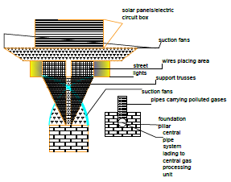
Detailed Description

Slide 3
Major Carbon Eater {Ma.C.E}
The picture in previous slide is of the prime structure of Carbon eater.
It has Suction fans which help in sucking larger amounts of air. These fans will be operated with Solar energy or DC energy.
The unpure air will be carried away through pipe lines to process the air away from the source to central gas/ air processing unit.
Hepa grade filters will be used to absorb carbon.

Slide 4
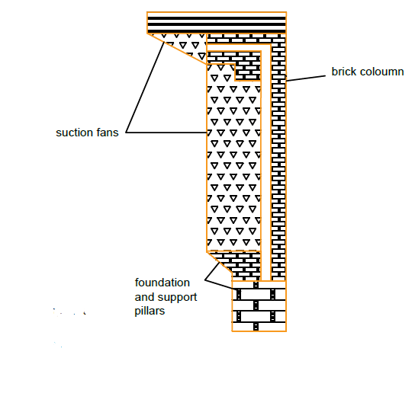
Main Part 0.2

Slide 5
Minor Carbon Eater {M.C.E}
This design is the next version or smaller version of main one.
The top of the M.C.E. has solar panels/ DC source.
This will also be working similar to the previous version. Maximum efficiency will be reduced compared to the previous version.

Slide 6
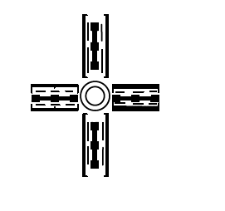
Rotary Carbon Eater
This was designed to place on Rotary of roads.
The working is same as the previous ones.
The main advantage of this is it is 95% more effective as compared to previous versions.

Slide 7
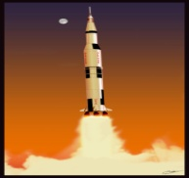
Purpose
Main Purpose of these machines was to reduce the pollution of vehicles at point source.
It can also be used in Rocket launch sites and can absorb rocket soot.
It can reduce infact eliminate the carbon content in local atmosphere.

Slide 8
Purpose
To reduce the pollutants in atmosphere.
To reduce carbon dioxide, carbon monoxide and whatever dust or smoke particles, carbon eaters are hungry for all the bad substances in air.
Many of the lives can be saved by reducing pollution in atmosphere.
It was mainly designed for vehicular traffic, but it can be used in industries, Rocket launches etc.

